Slide 1
NUTRITION IN THE CONTEXT OF HIV AND AIDS

Slide 2
NUTRITION
Nutrition is the intake of food in relation to the body’s dietary needs.
It constitutes a metabolic process i.e. ingestion, absorption, assimilation, biosynthesis, catabolism and excretion.
Good nutrition refers to adequate, well balanced diet combined with regular physical activity.
Poor nutrition can thus lead to reduced immunity, increased susceptibility to disease, impaired physical and mental development and reduced productivity.

Slide 3
Macronutrients – these are needed in relatively large amounts i.e. many grams/day. They include carbohydrates, fats and proteins.
Micronutrients – These are needed in small quantities i.e. <1g/day. They include vitamins and minerals.
Nutritional status – The body’s response to nutrients and the subsequent outcome.
Diet – Amount and type of food and drink a person eats.

Slide 4
EFFECTS OF HIV/AIDS ON NUTRITION
HIV infection increases nutrient requirements and at the same time impairs nutrient intake and absorption.
HIV/AIDS increases risk of malnutrition through altered food intake and or its nutrient absorption and utilization.
Poor nutrition increases risk of opportunistic infections and accelerates progression of HIV/AIDs .
Malnutrition and HIV/AIDS are synergetic and together create a vicious cycle that additively weakens the immune system.

Slide 5
N/B – The emergence of opportunistic infections further increases energy and nutrient needs. Moreover, psychological stress affects nutrient intake and can contribute to the risk of malnutrition. In a real sense, the relationship between nutrition and HIV/AIDS is a vicious cycle.

Slide 6
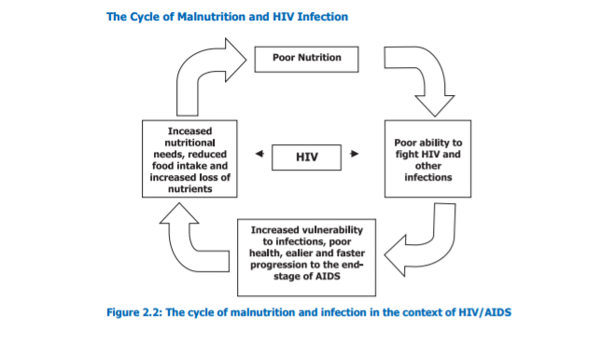

Slide 7
NUTRITIONAL NEEDS FOR PLWHAS
Nutritional needs for PLWHAS are influenced by several factors i.e. age, physiological changes, level of physical activity, clinical state of health, metabolic rate and viral load count.
To maintain good nutrition, an adequate intake of energy giving foods, proteins, vitamins and minerals, fibre and water are vital.

Slide 8
ENERGY GIVING FOODS
These include carbohydrates, sugars, fats and oils.
Main staples of carbohydrates in Kenya are: maize, rice, potatoes, sorghum, cassava, wheat, sweet potatoes, millet and green bananas.
Sugars mainly constitute cane table sugar, honey, jam, cakes etc.
Fats and oils – They provide more than twice the energy of an equivalent amount of carbohydrates. They add flavor and taste to food, maintain function and integrity of cell membrane structure and enhance absorption of fat soluble vitamins (A,D,E and K). Good fats lower cholesterol and reduce risk of heart diseases. They include polyunsaturated oils (vegetable oils),omega 3 oils (fish and soy beans) and monounsaturated fats (peanuts, coconuts, olives and avocados). Avoid excess saturated and trans fats (margarine)

Slide 9
PROTEINS
These are body building foods.
There requirements increase with age from early childhood to adolescence.
Optimum intake is 1g/kg body weight.
Adults = 1.2 – 1.5g/kg body weight.
Children = 2.5 – 3g/kg body weight.
Main sources are Animals (milk and milk products, beef, poultry, fish) and plants (beans, peas, green grams, lentils, ground nuts)

Slide 10
VITAMINS AND MINERALS
Mainly fat soluble and water sole (b and c)
Sources include vegetables and fruits.

Slide 11
NUTRITIONAL CARE AND SUPPORT FOR PLWHAS
Key objectives are:
To prevent weight loss and to maintain normal nutritional status.
Restore nutritional status for severely malnourished PLWHAS.
Optimize health for PLWHAS and reduce stigma.

Slide 12
NUTRITION INDICATORS
BMI
Z-score Weight for height
MUAC
Height for Age
Weight for Age

Slide 13
BODY MASS INDEX
BMI: Mainly used for adults (W/H/A for children) but not pregnant and lactating women.
Computation of BMI
Weight in kg
Divide by the square of height in m (taken at nearest centimeter and converted to meters)
BMI = ^{Weight (kg) .}
^{ht x ht (m x m)}
BMI is expressed in kg/m² (though the units are often not indicated)

Slide 14
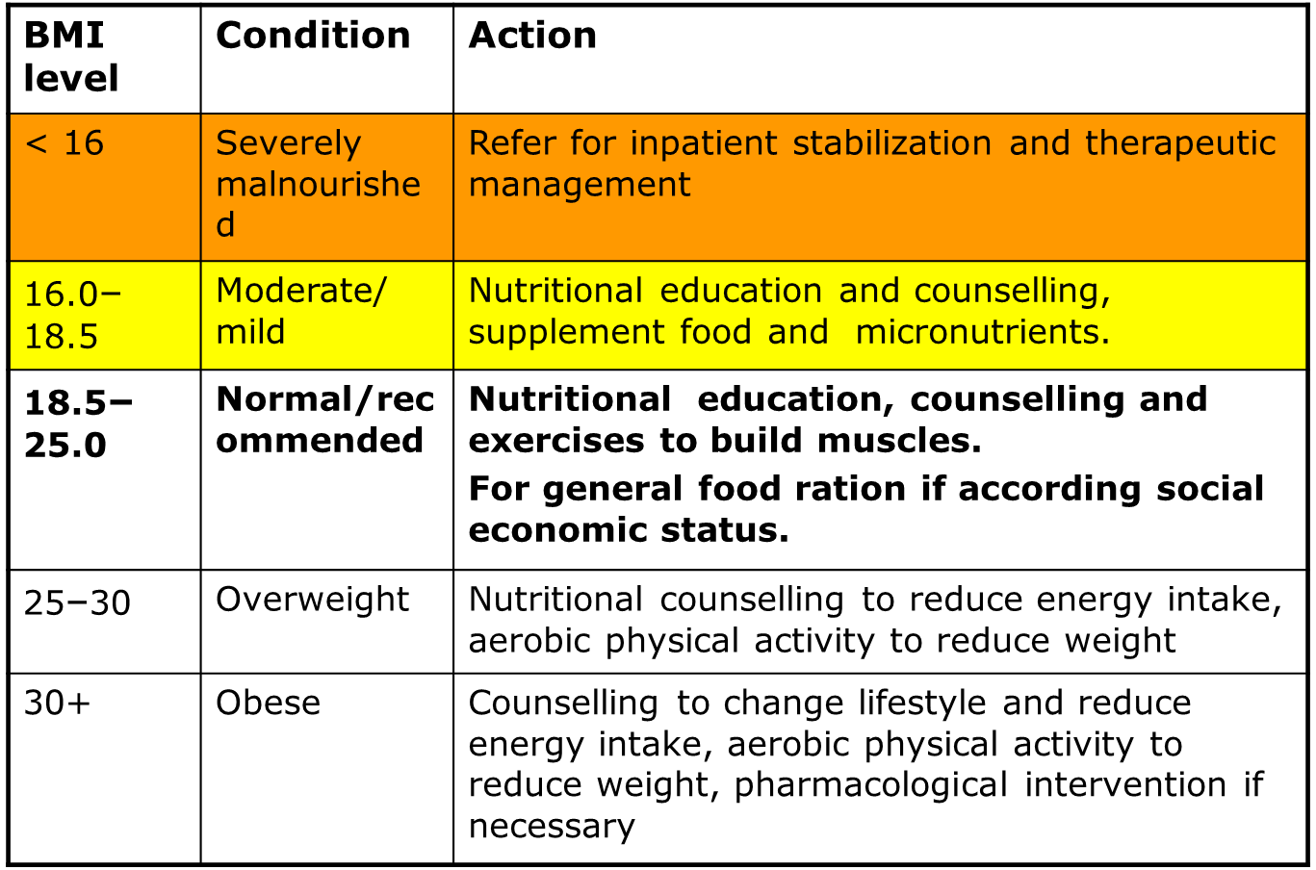
BMI FOR ADULTS AND ACTIONS TO TAKE

Slide 15
MAXIMIZING INTAKE DURING ACUTE INFECTIONS
Provide medications for the underlying condition (e.g. oral/ esophageal candidiasis)
Mouth or throat pain: patient counseling
Avoid foods that cause pain (e.g. citrus, spicy)
Avoid very sweet foods
Drink high-energy, high-protein liquids with a straw, if possible
Eat foods at room temperature or cooler
Eat thick, smooth foods such as porridge, pudding, mashed potatoes and carrots or non-acidic fruits and vegetables

Slide 16
Nausea and vomiting: patient counseling
Eat small snacks throughout the day
Avoid large meals
Eat toast and other plain dry foods
Avoid foods that have a strong aroma
Drink diluted fruit juices, liquids, soup
Eat simple boiled foods such as porridge, potato, beans
Drink herbal teas and lemon juice in hot water
If available, drink ginger root: crush ginger in cold water, boil in water for 1 minutes, place in covered container, strain ginger and drink liquid

Slide 17
Fever and loss of appetite: patient counseling
Drink high-energy, high-protein liquids and fruit juices such as soups, maize, potatoes, carrots, and nectars
Eat small portions of soft, preferred foods with a pleasing aroma and texture throughout the day
Frequent small feeds or fruits in between meals.
Drink liquids often e.g.; fruit juices, milk, soup, tea, cocoa etc

Slide 18
The client is required to take periodic nutritional status assessment i.e. weight check every 2nd month for symptomatic patients and every 4th month for the asymptomatic.
Educate and counsel PLWHAS of increased energy needs for their disease stage and the need to consume a balanced diet.
Educate and support clients to maintain high levels of sanitation, food hygiene and water safety at all times. Deworming is done bi annually in this regard.
They must practice positive living behaviors i.e. safe sex, no alcohol and non prescription drug use, no smoking.
Seeking prompt treatment for all opportunistic infections especially those interfering with food intake.
Carrying out physical activity and exercises to strengthen and build muscles, increase appetite and improve health.

Slide 19
NUTRITIONAL MANAGEMENT OF ACUTE HIV/AIDS MALNUTRITION
Patients with acute HIV/AIDS malnutrition are categorized by their inability to eat, appetite changes and degree of gut impairment/inability to absorb nutrients.
Management options available include:
Sip Feeding – For the severely malnourished and weak individuals WITH appetite and are able to feed. High energy formulations e.g. Therapeutic milk (F75, F100TM, BP100TM, NUTREN TM, PLUMPYNUT TM) are used.
Enteral Feeding – Recommended for those who cannot take food or liquids orally. NGT/ GSTRONOMY/ JEJUNOSTOMY feeding is done. Enteral feeds may be commercial preparations indicated under sip feeds or blended mixtures prepared from regular foods.
Parenteral Feeding – Recommended when the GIT is non functional e.g. severe PEM, preparation for surgery/ profound anorexia/ severe diarrhea/ intractable vomiting.

Slide 20
DRUGS AND FOOD/NUTRIENT INTERACTIONS
A range of drugs are used to manage the symptoms of HIV infection, opportunistic infections and other common infections. Thus food and drug interactions may be positive or negative.
Drugs may alter nutrient absorption, metabolism, distribution and excretion thus affecting nutritional status of the patient.
Food may affect efficacy of medication due to altered absorption, metabolism, distribution and excretion.
Some drugs may lower food intake and absorption. For instance some drugs have diet restrictions (tetracycline and milk/milk products) and side effects of many drugs affect the GIT (anorexia, change in taste, diarrhea), CNS (fatigue, depression, insomnia)
The interaction of drugs along with nutritional status of the patient affects drug efficacy, tolerability and adherence.

Slide 21
N/B:
All PLWHA qualify for ARVs, but those with a BMI of less than 16kg/m² should be nutritionally stabilized (with therapeutic foods or nutritional rehabilitation)
Staff who provide ART must know the food and nutrition implications of different ARVs and advise patients appropriately. For instance the interaction of certain dietary constituents e.g. high fat meal increases bioavailability of tenofovir.

Slide 22
NUTRITION RELATED SIDE EFFECTS OF ARVs
High blood cholesterol: interventions: reduce dietary fat intake and increase daily vegetable and fruit intake plus regular exercise.
High triglycerides: intervention: limit saturated and trans fats intake, moderate carbohydrates intake, increase intake of grain cereals and exercise regularly.
Peripheral neuropathy: intervention: supplementation with vitamins B
Liver damage.
Kidney stones.

